Slide 1
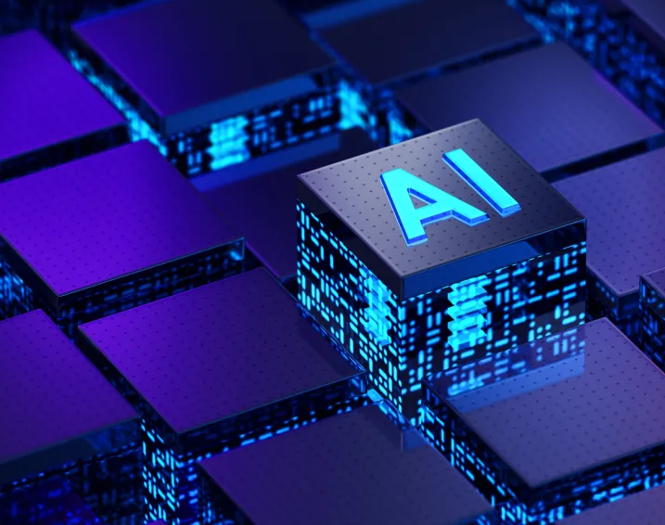
THE AGE OF ARTIFICIAL INTELLIGENCE
ANANYA CANAKAPALLI
AXC230004

Slide 2
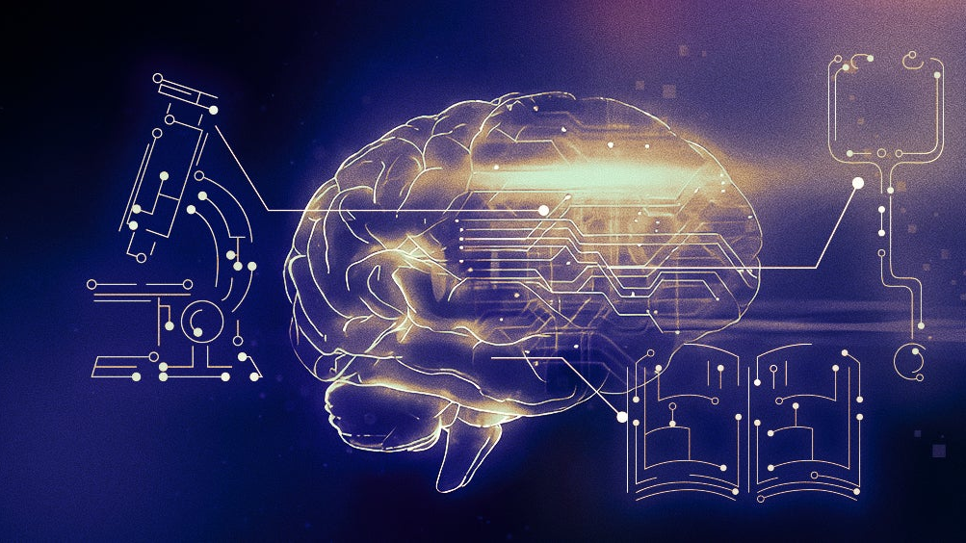
The Age of AI Has Begun: Bill Gates’ Vision
Artificial Intelligence denotes a model designed to address a specific problem or deliver a particular service while Artificial General Intelligence is a software that is capable of learning any task.
Bill Gates identifies the rise of AI as a revolutionary technological advancement.
AI is poised to redefine work, education, health, and communication, necessitating an industry-wide shift.
Businesses will distinguish themselves by how well they use it.

Slide 3
Benefits & Challenges
BENEFITS
AI's potential in addressing global health include assisting health-care workers, enabling access to healthcare in poor countries, aid in medical breakthroughs, and agriculture
A transformative impact on education, offering personalized learning experiences
Boosts in productivity through tasks automation and enhanced work processes
Advances in AI will enable the creation of personal agents
CONCERNS
The possibility of factual errors, hallucinations and lack of context understanding
Ethical implications, like the digital divide, biased datasets, and privacy might exacerbate existing inequities
The misuse of AI in malicious endeavors
The potential for AIs to become uncontrollable or misaligned with human goals

Slide 4
Navigating the AI Era: A Balanced Approach
AI's rapid development is transforming various industries, with a surge in companies exploring new applications and improved technology.
Advances in AI hardware, such as energy-efficient chips and processing power, aim to enable AI to run on personal devices, reducing the reliance on cloud computing.
Software enhancements, particularly in AI algorithms, are expected to boost AI accuracy within specific domains with targeted training data.
The widespread discussion about AI's impact on society will continue, with Bill Gates suggesting to balance the downsides of AI.
Gates emphasizes the importance of using AI to reduce global inequities, especially in supporting underprivileged communities, as the potential for AI to address societal issues becomes increasingly evident.

Slide 5
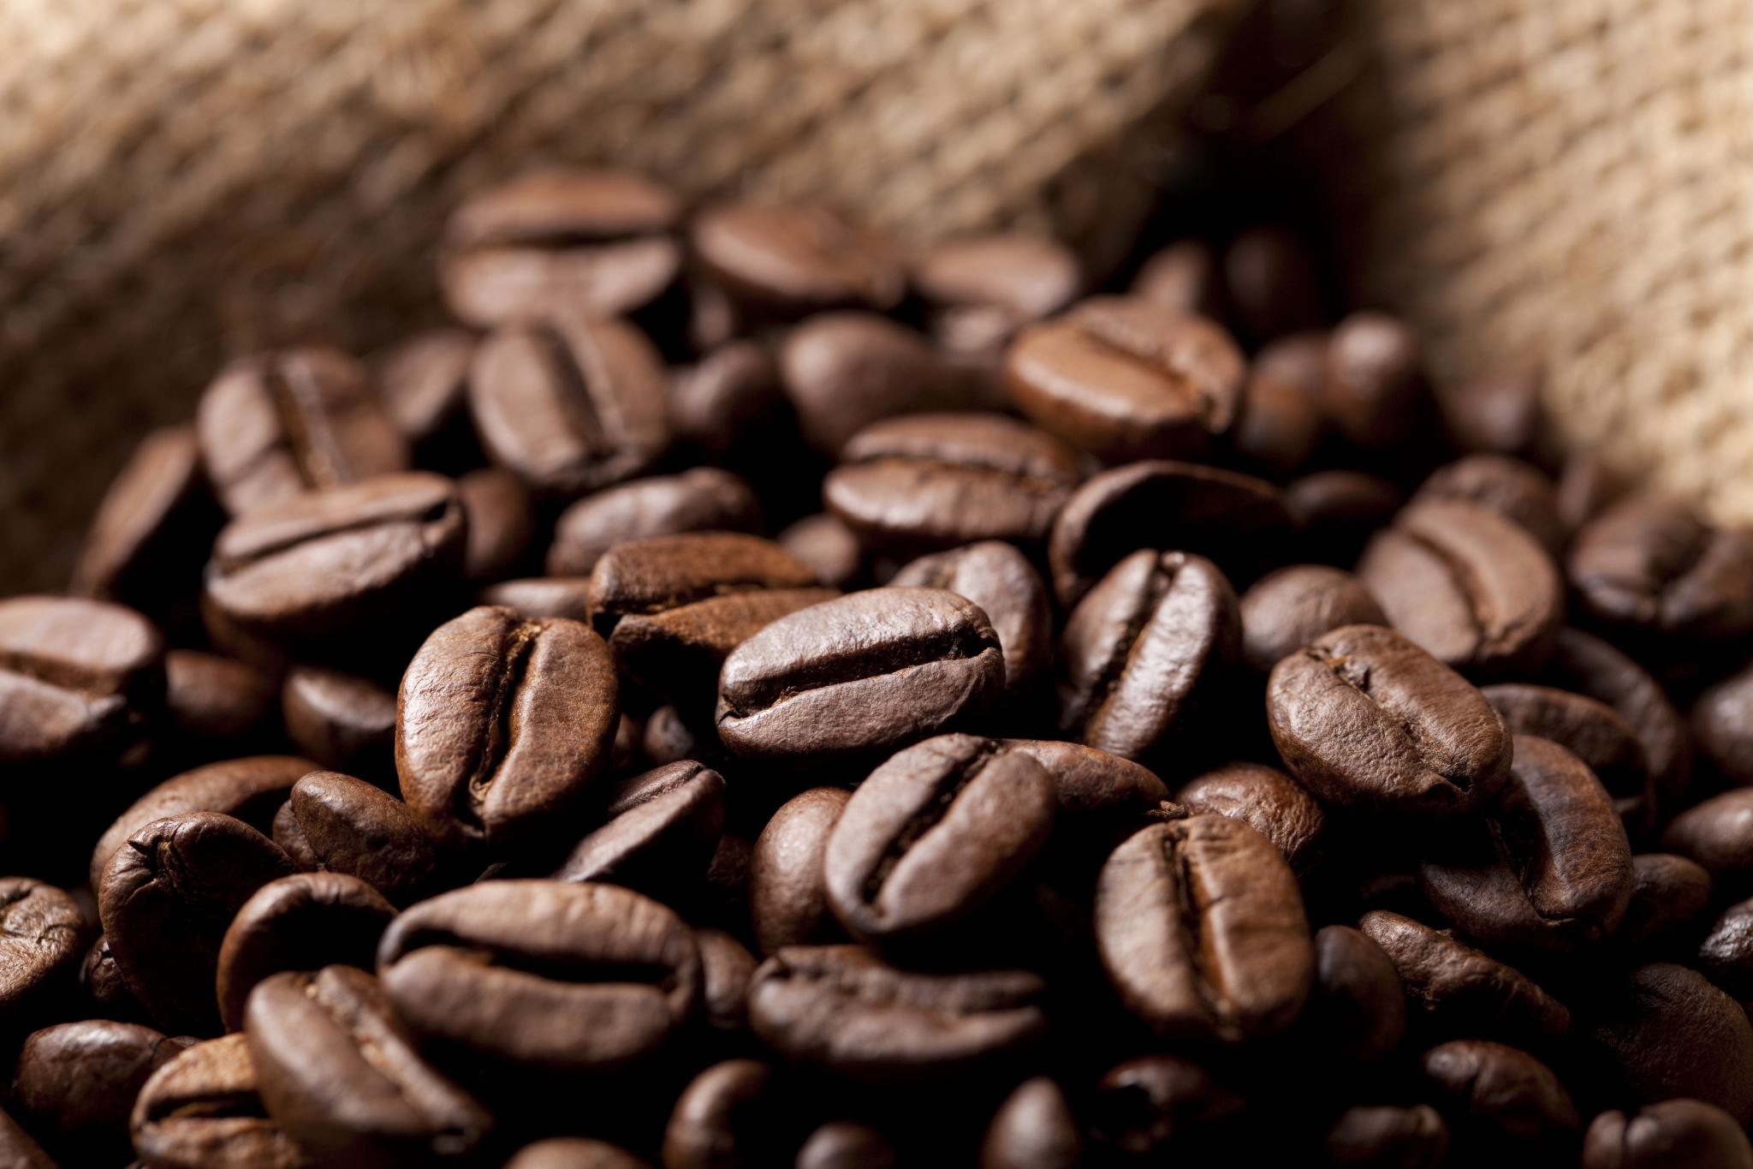


Use Case 1: AI-Driven Coffee Flavor Profiling & Blending
COFFEE INDUSTRY
Coffee producers aim to create unique and consistent flavors for their coffee blends. AI can analyze bean origin, roast level, and brewing method to optimize coffee blend compositions.
Flavor Consistency: AI can provide real-time adjustments to maintain desired flavors.
Customization: AI can enable the creation of personalized coffee blends to meet individual preferences, which is impractical with traditional blending methods.
Cost Optimization: AI can help optimize the use of various coffee beans in blends to minimize costs while maintaining flavor quality.

Slide 6
Use Case 1: AI-Driven Coffee Flavor Profiling & Blending
ADVANTAGES TO CONSUMERS
Personalized Coffee: AI allows consumers to enjoy coffee with flavor profiles tailored to their preferences.
ADVANTAGES TO ENTERPRISES
Product Innovation: AI enables the development of unique and marketable coffee blends.
Cost Efficiency: Coffee producers can reduce costs and wastage by optimizing blend compositions.
Market Differentiation: Coffee brands can stand out in a competitive market by offering unique and personalized blends.
RISKS
Data Privacy: AI systems collect and analyze consumer data to create personalized blends, which raises concerns about data privacy and security.
Algorithm Bias: AI algorithms must be carefully trained to avoid introducing bias into flavor profiles, ensuring that they align with diverse consumer preferences.
Quality Control: Relying on AI without human oversight can lead to errors in blend compositions, affecting the quality of coffee products.
SOLUTION
This system utilizes machine learning algorithms to understand individual consumer preferences and create coffee flavors and blends that align with their taste profiles.

Slide 7


Use Case 2: AI-Powered Coffee Supply Chain Optimization
AI plays a vital role in optimizing the coffee supply chain. From coffee bean sourcing to distribution and logistics, AI-driven solutions can improve efficiency and sustainability by analyzing vast amounts of data to make data-driven decisions. This is particularly relevant in the coffee industry, where beans come from diverse sources and require careful handling to maintain quality.
Chain Visibility: AI can provide real-time visibility into the entire coffee supply chain, from bean origin to retail shelves. Traditional supply chain management may lack this level of real-time information.
Quality Control: AI can monitor coffee beans' quality as they move through the supply chain, ensuring that only the best beans are selected and roasted. Traditional quality control methods may miss issues that AI can detect.
Sustainability: AI can optimize transportation routes, reduce waste, and promote sustainable sourcing practices, helping the coffee industry minimize its environmental footprint.

Slide 8
Use Case 2: AI-Powered Coffee Supply Chain Optimization
ADVANTAGES TO CONSUMERS
Quality Assurance: AI-driven supply chain optimization ensures that consumers receive high-quality coffee products consistently.
Traceability: AI can provide consumers with detailed information about the origin and journey of their coffee, enhancing transparency.
ADVANTAGES TO ENTERPRISES
Cost Reduction: AI can reduce operational costs by optimizing inventory management, transportation, and logistics.
Reduced Waste: AI can minimize waste by optimizing inventory and distribution, contributing to sustainability efforts.
RISKS
Cybersecurity: The interconnected nature of AI systems in the supply chain makes them susceptible to cyberattacks, which can disrupt operations and compromise data.
Overreliance on Automation: Overreliance on AI without human oversight may lead to errors or issues going undetected.
SOLUTION
AI in coffee supply chain optimization will be used to analyze real-time data from various sources such as weather conditions, demand trends, and transportation logistics, enabling data-driven decision-making for inventory management, and route optimization.

Slide 9
REFERENCES
The Future of Coffee with Artificial Intelligence, https://sumatocoffee.com/blogs/coffee-connections/the-future-of-coffee-with-artificial-intelligence
How Will Artificial Intelligence Affect the Coffee Industry? Embracing a Tech-Driven Future, https://usroast.com/blogs/news/how-will-artificial-intelligence-affect-the-coffee-industry-embracing-a-tech-driven-future
From Bean to Cup: How the Coffee Supply Chain Works, https://club.atlascoffeeclub.com/coffee-supply-chain/
Coffee Supply Chain: Discover Success Strategies and Stories, https://viindoo.com/blog/business-management-3/coffee-supply-chain-1454

